Slide 1
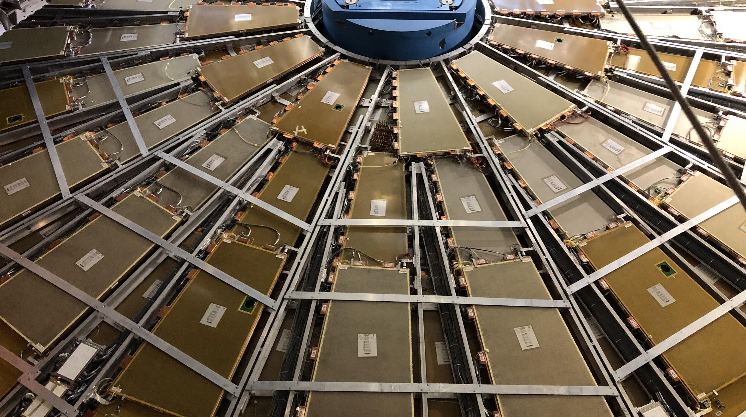


CIS Tech Update
Chicago Meeting, August 15th, 2022
Peter Camporeale and Jacky Li

Slide 2
Table of Contents
CIS Updates
June 23 - July 14
July 15 – August 9
Low Voltage Power Supply / DCS
L1 Trigger system
Fast Calo Simulation
Testbeam
Life

Slide 3
1.a) June 23 – July 14 CIS update
Transition from last generation of Katie and Dawit to Peter and Jacky

Slide 4
1.b) July 15 – August 9 CIS update
Independently done by Peter and Jacky

Slide 5
2. LVPS & DCS
Connected with Filipe Martins
Done:
Generated code for checking DCS values (Pending checking with Filipe)
To do:
Put the code into TIO
…
…

Slide 6
3. L1 Trigger system
Connected with Danijela Bogavac
Done:
Given overview of system and a tour in control room
To do:
Codes review?

Slide 7
4. FCS
Knowledge Transferred from Dawit
Done:
Recreated plots
To do:
None, until further notice.

Slide 8
5. Test Beam
Meeting with Irakli Minashvili
Done:
Checked the legacy system in tiles in Test Beam.
To do:
Shift training.
None, until further notice. (Irakli is taking his vacation)

Slide 9
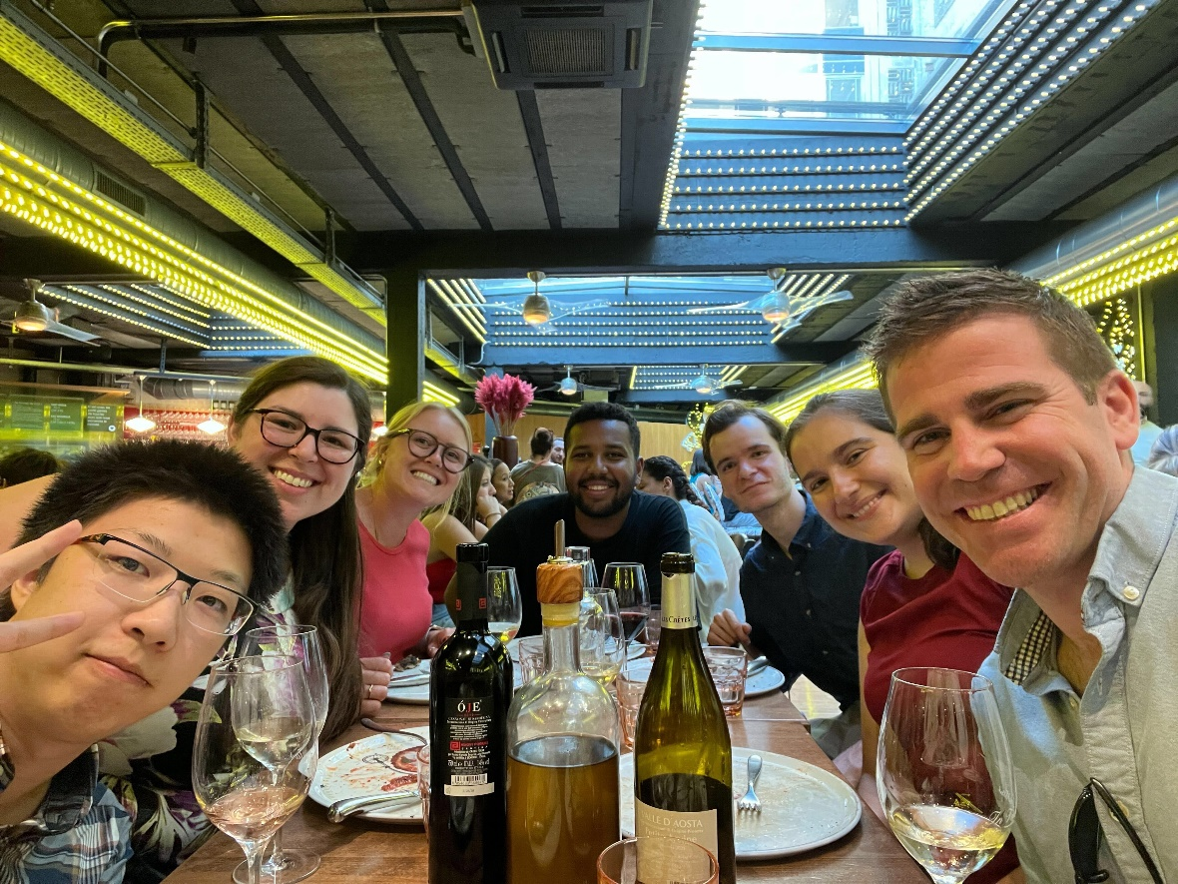
6. Life -1
Old CIS techs leaving
Katie has returned to Chicago on July 25
Dawit is going to return to Chicago in August ?
Prof. David Miller’s visit late June
Getting settled in the City
Learning/Refreshing driving manual
Control Room Shifts
June 29th , Dinner at Luigi’s

Slide 10
6. Life -2
Peter taking shifts in ATLAS control room
Jacky teaching Peter driving manual

Slide 11
Questions
[If we have any questions, put them here]

Slide 12
Thank you for Listening!
Any further questions?

